Slide 1
Chapter 4
Physics-based Prognostics

Slide 2
1. Introduction to Physics-based Prognostics

Slide 3
Parameter Estimation in Prognostics
Physics-based prognostics: there exists a physical model that describes the evolution of damage or degradation (degradation model)
Key issues: how to improve the accuracy of degradation model and how to incorporate uncertainty in the future
Sources of uncertainty
  Uncertainty in model parameters
  Uncertainty in loading conditions
  Error in the model form
Decision-making process of prognostics should include these sources of uncertainty and should be based on conservative estimate of damage degradation

Slide 4

Illustration of Physics-based Prognostics
Degradation model $=f\left(Loading (L\right), time \left(t\right), parameters (θ))$
  Assume loading conditions and time are given
  This chapter focuses on identifying model parameters and predicting the future behavior of degradation

Slide 5
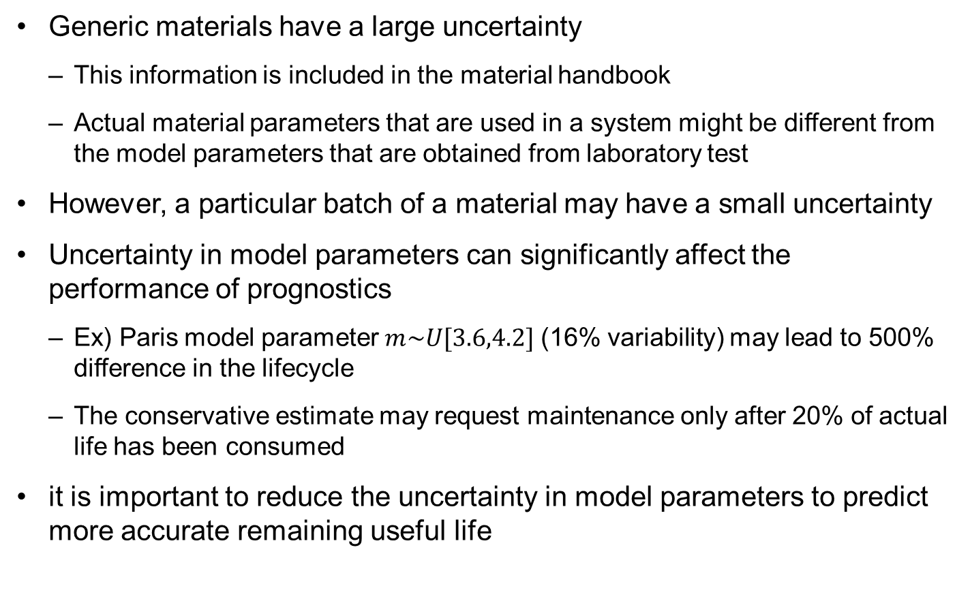
Uncertainty in Model Parameters
Generic materials have a large uncertainty
  This information is included in the material handbook
  Actual material parameters that are used in a system might be different from the model parameters that are obtained from laboratory test
However, a particular batch of a material may have a small uncertainty
Uncertainty in model parameters can significantly affect the performance of prognostics
  Ex) Paris model parameter $m\sim U[3.6,4.2]$ (16% variability) may lead to 500% difference in the lifecycle
  The conservative estimate may request maintenance only after 20% of actual life has been consumed
it is important to reduce the uncertainty in model parameters to predict more accurate remaining useful life

Slide 6

Effect of Model Parameter Uncertainty
N=0:100:4000;sig=70;a0=0.001; m=3.6:0.1:4.2; C=5E-10; figure; hold on;
for i=1:7
a(i,:)=(N.*C*(1-m(i)/2)*(sig*sqrt(pi))^m(i)+a0^(1-m(i)/2)).^(2/(2-m(i)));
plot(N,a(i,:));
end
m=4.2
$$a_{N}$$
m=3.6
N

Slide 7
Epistemic Uncertainty in Model Parameters
uncertainty in model parameters is mostly from epistemic uncertainty
The fundamental concept of physics-based prognostics is to use measurement data to reduce the uncertainty in model parameters
  measurement data can be used to reduce the uncertainty in degradation model parameters using the Bayesian framework
  most physics-based prognostics methods have their foundation on Bayesian inference
Once model parameters are identified, the future behavior of degradation can be predicted by propagating the model to the future
  substitute the identified parameters to the degradation model with future time and loadings
  the RUL is predicted by propagating the degradation state until it reaches a threshold

Slide 8
Physics-based Prognostics Methods
Physics-based prognostics methods are based on parameter estimation algorithms
Nonlinear least squares (NLS): nonlinear version of least squares method
Bayesian method (BM): Overall Bayesian inference
Kalman filter (KF): exact posterior distribution in the case of a linear system with Gaussian noise
Extended/unscented Kalman filter: for nonlinear systems
Particle filter (PF): represent the posterior distribution using particles

Slide 9

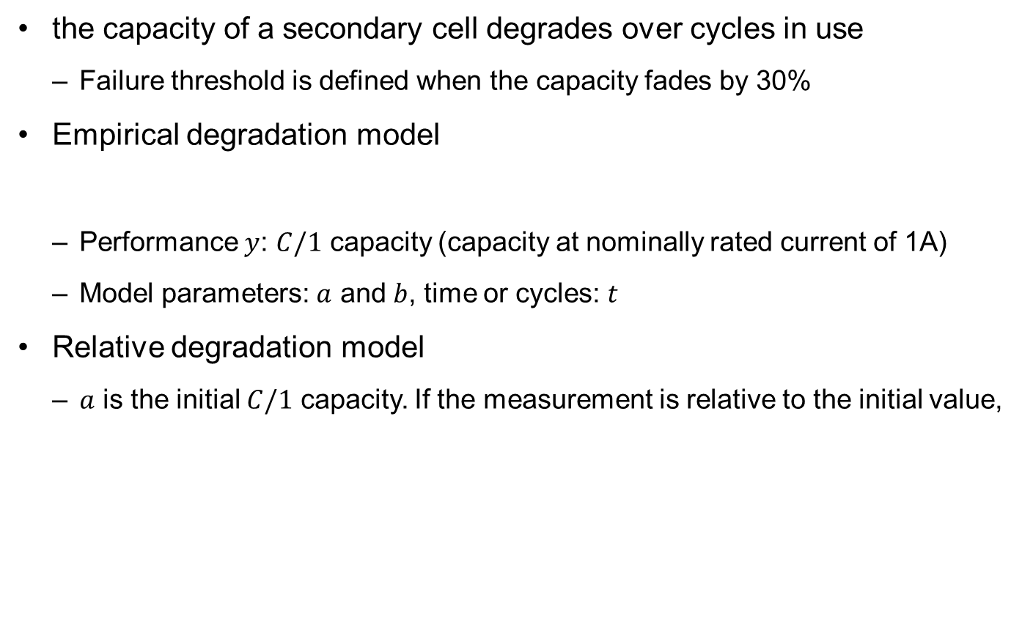

Demonstration Problem: Battery Degradation
the capacity of a secondary cell degrades over cycles in use
  Failure threshold is defined when the capacity fades by 30%
Empirical degradation model
  Performance $y$: $C/1$ capacity (capacity at nominally rated current of 1A)
  Model parameters: $a$ and $b$, time or cycles: $t$
Relative degradation model
  $a$ is the initial $C/1$ capacity. If the measurement is relative to the initial value,
$$y=aexp(−bt)$$
$$z_{k}=exp(−bt_{k})$$

Slide 10
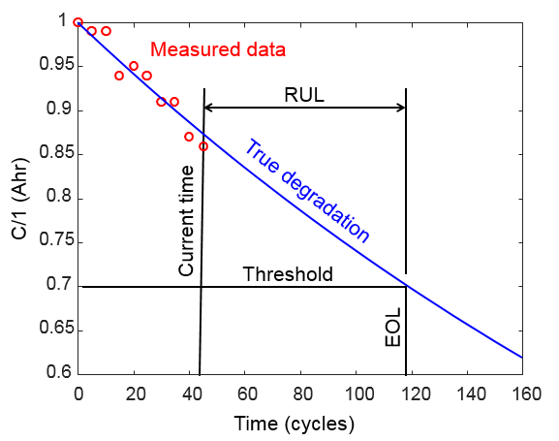
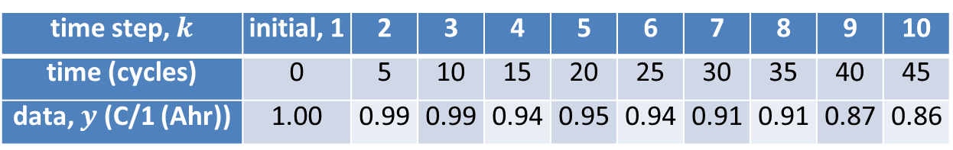

Degradation Data
Measured $C/1$ capacity at every 5 charging-discharging cycles
True parameter $b_{true}=0.003$
Added Gaussian noise
$ε\sim N({0,0.02}^{2})$
True parameter is only used
for data generation
EOL=118 cycles
time step, $k$ | initial, 1 | 2 | 3 | 4 | 5 | 6 | 7 | 8 | 9 | 10
time (cycles) | 0 | 5 | 10 | 15 | 20 | 25 | 30 | 35 | 40 | 45
data, $y$ (C/1 (Ahr)) | 1.00 | 0.99 | 0.99 | 0.94 | 0.95 | 0.94 | 0.91 | 0.91 | 0.87 | 0.86

Slide 11
2. Nonlinear Least Squares (NLS)

Slide 12
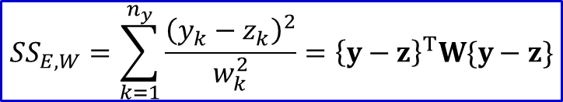

Nonlinear Least Squares Method
We used least squares method in Chapter 2
  Regression: when unknown model parameters are linear in the model
Nonlinear least squares (NLS)
  When the model parameters are nonlinear relationship in the model
How do you know a model is nonlinear?
  Derivatives depends on parameters
Ex) Battery degradation
NLS finds the best parameters using the weighted sum of square errors
$$\frac{dz(t;b)}{db}=−texp(−bt)$$
$$SS_{E,W}=\sum_{k=1}^{n_{y}}{\frac{{\left(y_{k}−z_{k}\right)}^{2}}{w_{k}^{2}}}={\left\{y−z\right\}}^{T}W\{y−z\}$$
Weights at measurement point

Slide 13
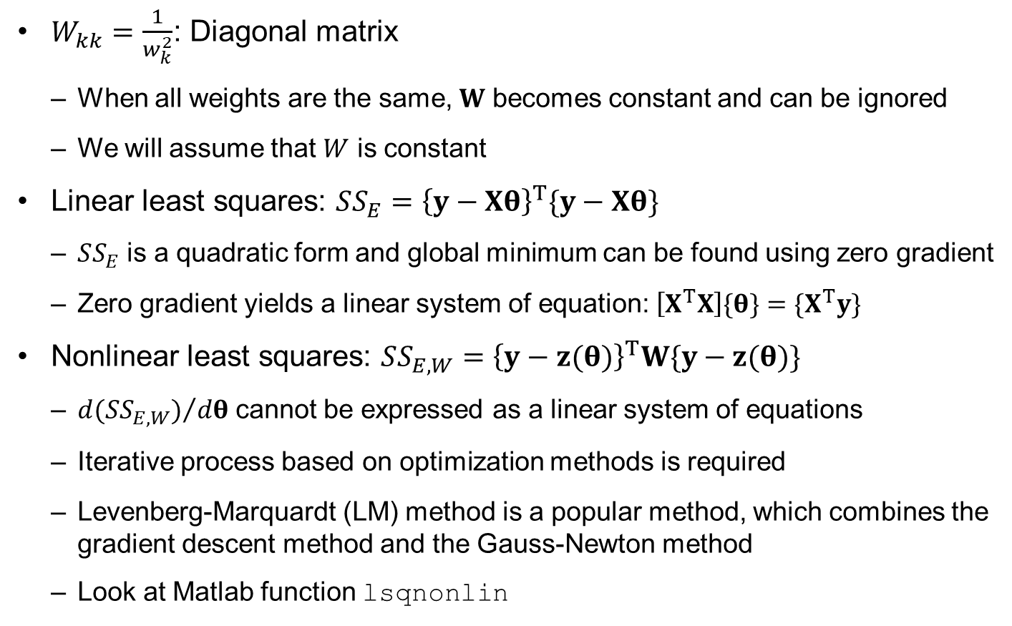
Nonlinear Least Squares Method cont.
$W_{kk}=\frac{1}{w_{k}^{2}}$: Diagonal matrix
  When all weights are the same, $W$ becomes constant and can be ignored
  We will assume that $W$ is constant
Linear least squares: $SS_{E}={\left\{y−Xθ\right\}}^{T}\{y−Xθ\}$
  $SS_{E}$ is a quadratic form and global minimum can be found using zero gradient
  Zero gradient yields a linear system of equation: $\left[X^{T}X\right]\{θ\}=\{X^{T}y\}$
Nonlinear least squares: $SS_{E,W}={\left\{y−z(θ)\right\}}^{T}W\{y−z(θ)\}$
  ${d(SS_{E,W})}/{dθ}$ cannot be expressed as a linear system of equations
  Iterative process based on optimization methods is required
  Levenberg-Marquardt (LM) method is a popular method, which combines the gradient descent method and the Gauss-Newton method
  Look at Matlab function lsqnonlin

Slide 14

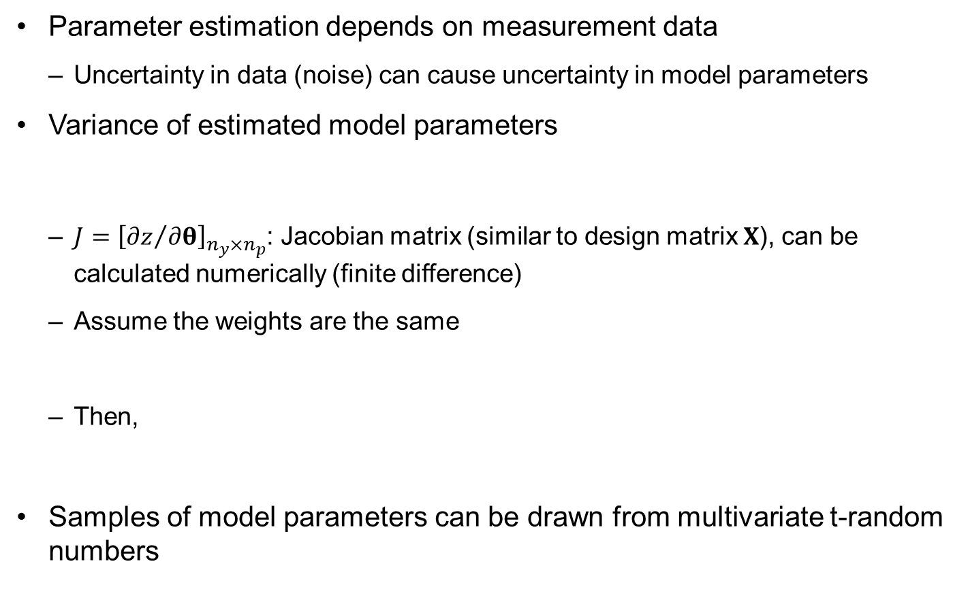

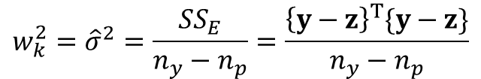
Uncertainty in NLS
Parameter estimation depends on measurement data
  Uncertainty in data (noise) can cause uncertainty in model parameters
Variance of estimated model parameters
  $J={\left[{∂z}/{∂θ}\right]}_{n_{y}×n_{p}}$: Jacobian matrix (similar to design matrix $X$), can be calculated numerically (finite difference)
  Assume the weights are the same
  Then,
Samples of model parameters can be drawn from multivariate t-random numbers
$$Σ_{\hat{θ}}={\left[J^{T}WJ\right]}^{−1}$$
$$w_{k}^{2}={\hat{σ}}^{2}=\frac{SS_{E}}{n_{y}−n_{p}}=\frac{{\left\{y−z\right\}}^{T}\{y−z\}}{n_{y}−n_{p}}$$
$$Σ_{\hat{θ}}={\hat{σ}}^{2}{\left[J^{T}J\right]}^{−1}$$

Slide 15
NLS: Matlab code for Nonlinear Least Squares
function [thetaHat,rul]=NLS(theta0)
clear global; global DegraUnit TimeUnit ...
time y thres ParamName thetaTrue signiLevel ns ny nt np
%=== PROBLEM DEFINITION 1 (Required Variables) ==============
WorkName=' '; % work results are saved by WorkName
DegraUnit=' '; % degradation unit
TimeUnit=' '; % time unit (Cycles, Weeks, etc.)
time=[ ]'; % time at both measurement and prediction
y=[ ]'; %[nyx1]: measured data
thres= ; % threshold (critical value)
ParamName=[ ]; %[npx1]: parameters' name to be estimated
thetaTrue=[ ]; %[npx1]: true values of parameters
signiLevel= ; % significance level for C.I. and P.I.
ns= ; % number of particles/samples

Slide 16
NLS Matlab Code cont.
%============================================================
% % % PROGNOSIS using NLS
ny=length(y); nt=ny;
np=size(ParamName,1); %% Deterministic Estimation
Optio=optimset('algorithm',{'levenberg-marquardt',0.01});
[thetaH,~,resid,~,~,~,J]=lsqnonlin(@FUNC,theta0,[],[],Optio);
sse=resid'*resid; %% Distribution of Theta
dof=ny-np+1;
sigmaH=sqrt(sse/dof); % Estimated std of data
W=eye(ny)*1/sigmaH^2; thetaCov=inv(J'*W*J);
sigTheta=sqrt(diag(thetaCov)); % Estimated std of Theta
mvt=mvtrnd(thetaCov,dof,ns)'; % Generate t-dist
thetaHat=repmat(thetaH,1,ns)+mvt.*repmat(sigTheta,1,ns);
thetaHat(np,:)=sigmaH*ones(1,ns); %% Final Sampling Results
for k=1:length(time(ny:end)); %% Degradation Prediction
zHat(k,:)=MODEL(thetaHat,time(ny-1+k));
degraPredi(k,:)=zHat(k,:)+trnd(dof,1,ns)*sigmaH;
end;

Slide 17
NLS Matlab Code cont.
% % % POST-PROCESSING
degraTrue=[]; %% True Degradation
if ~isempty(thetaTrue); degraTrue=MODEL(thetaTrue,time); end
rul=POST(thetaHat,degraPredi,degraTrue); %% RUL & Result Disp
Name=[WorkName ' at ' num2str(time(ny)) '.mat']; save(Name);
end
function objec=FUNC(theta)
global time y ny
z=MODEL(theta,time(1:ny));
objec=(y-z);
end
function z=MODEL(theta,t)
global ParamName np
for j=1:np-1; eval([ParamName(j,:) '=theta(j,:);']); end
%===== PROBLEM DEFINITION 2 (model equation) ===============
%===========================================================
end

Slide 18
NLS Code Explanation
Matlab code NLS is a template
  Users can define their own degradation model with unknown model parameters
Problem definition for user-specific applications
  Variable definition
  Model definition
Prognostics using NLS
Post-processing for displaying results

Slide 19
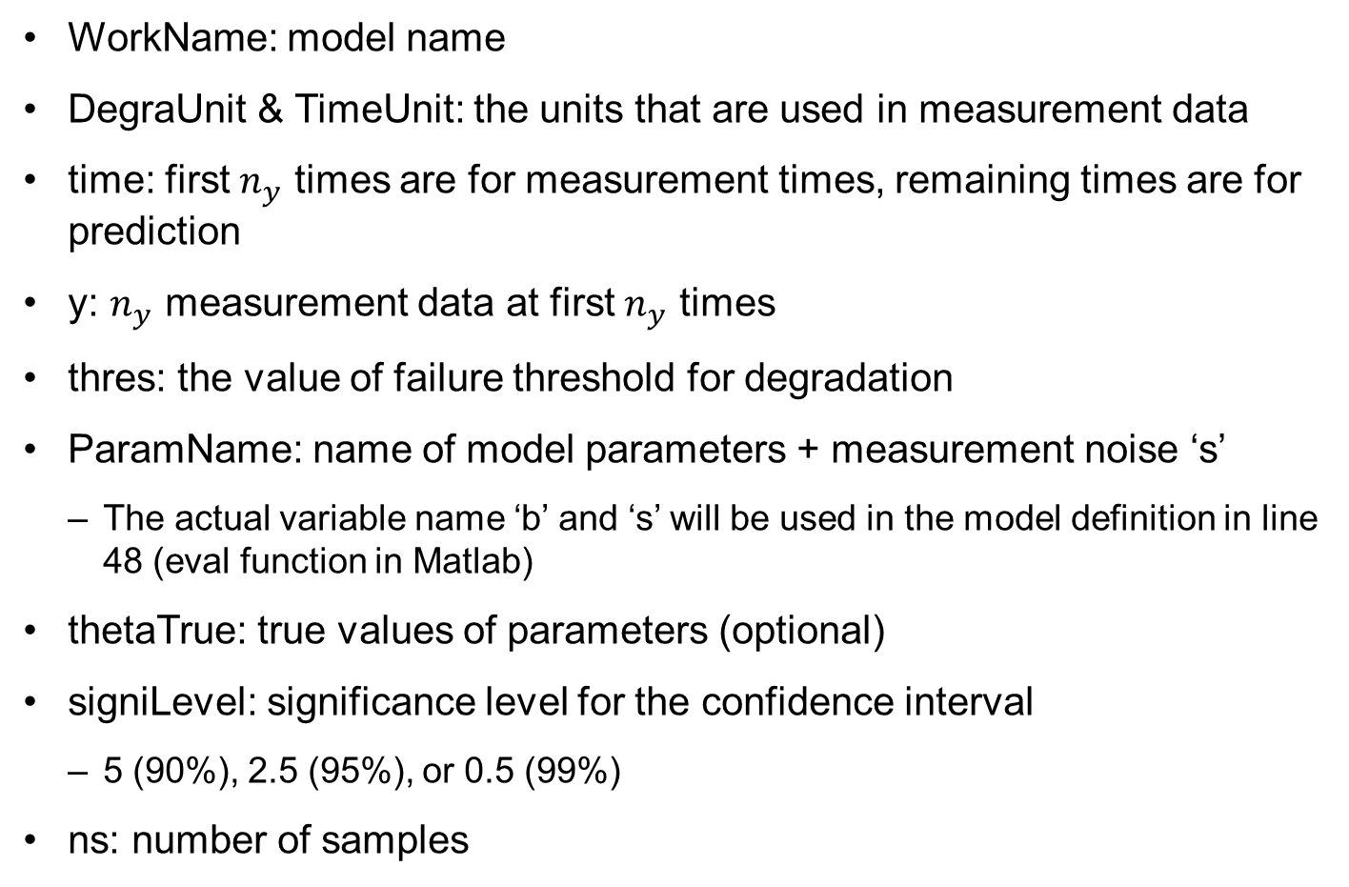
Problem Definitions (lines 5-14, 48)
WorkName: model name
DegraUnit & TimeUnit: the units that are used in measurement data
time: first $n_{y}$ times are for measurement times, remaining times are for prediction
y: $n_{y}$ measurement data at first $n_{y}$ times
thres: the value of failure threshold for degradation
ParamName: name of model parameters + measurement noise ‘s’
  The actual variable name ‘b’ and ‘s’ will be used in the model definition in line 48 (eval function in Matlab)
thetaTrue: true values of parameters (optional)
signiLevel: significance level for the confidence interval
  5 (90%), 2.5 (95%), or 0.5 (99%)
ns: number of samples

Slide 20
Problem Definition for Battery Degradation
Lines 5-14
Line 48
WorkName='Battery_NLS';
DegraUnit='C/1 Capacity';
TimeUnit='Cycles';
time=[0:5:200]';
y=[1.00 0.99 0.99 0.94 0.95 0.94 0.91 0.91 0.87 0.86]';
thres=0.7;
ParamName=['b'; 's'];
thetaTrue=[0.003; 0.02];
signiLevel=5;
ns=5e3;
z=exp(-b.*t);

Slide 21

Prognostics Using NLS (lines 17-32)
Use LM algorithm with more dominant use of Gauss-Newton update
Minimize FUNC starting from theta0 using lsqnonlin
Optio=optimset('algorithm',{'levenberg-marquardt',0.01});
[thetaH,~,resid,~,~,~,J]=lsqnonlin(@FUNC,theta0,[],[],Optio);
function objec=FUNC(theta)
global time y ny
z=MODEL(theta,time(1:ny));
objec=(y-z);
end
Calculate residual vector $e=y−z$
function z=MODEL(theta,t)
global ParamName np
for j=1:np-1; eval([ParamName(j,:) '=theta(j,:);']); end
%===== PROBLEM DEFINITION 2 (model equation) ===============
%===========================================================
end

Slide 22

Prognostics Using NLS
STD of data,$\hat{σ}$ (np includes s, but s is not model parameters)
Covariance of parameters, $Σ_{\hat{θ}}$
Generate samples of parameters using t-distribution
Propagate parameter samples to degradation samples
sse=resid'*resid; %% Distribution of Theta
dof=ny-np+1;
sigmaH=sqrt(sse/dof); % Estimated std of data
W=eye(ny)*1/sigmaH^2; thetaCov=inv(J'*W*J);
sigTheta=sqrt(diag(thetaCov)); % Estimated std of Theta
mvt=mvtrnd(thetaCov,dof,ns)'; % Generate t-dist
thetaHat=repmat(thetaH,1,ns)+mvt.*repmat(sigTheta,1,ns);
thetaHat(np,:)=sigmaH*ones(1,ns); %% Final Sampling Results
for k=1:length(time(ny:end)); %% Degradation Prediction
zHat(k,:)=MODEL(thetaHat,time(ny-1+k));
degraPredi(k,:)=zHat(k,:)+trnd(dof,1,ns)*sigmaH;
end;

Slide 23
Post-processing (lines 34-37)
Plots of model parameters and RUL using Matlab code POST
Save database to the disk
How to use NLS
  LM algorithm in lsqnonlin finds a local optimum (depending on initial)
%%% POST-PROCESSING
degraTrue=[]; %% True Degradation
if ~isempty(thetaTrue); degraTrue=MODEL(thetaTrue,time); end
rul=POST(thetaHat,degraPredi,degraTrue); %% RUL & Result Disp
Name=[WorkName ' at ' num2str(time(ny)) '.mat']; save(Name);
[thetaHat,rul]=NLS(0.01);

Slide 24

Matlab Code POST
function rul=POST(thetaHat,degraPredi,degraTrue)
Histogram of all parameters
Plotting degradation
  Percentile value [50% (median), $α\%, (100−α)\%$]
for j=1:np; subplot(1,np,j);
[frq,val]=hist(thetaHat(j,:),30);
bar(val,frq/ns/(val(2)-val(1)));
xlabel(ParamName(j,:));
end;
degraPI=prctile(degraPredi',perceValue)';
f1(1,:)=plot(time(1:ny),y(:,1),'.k'); hold on;
f1(2,:)=plot(time(ny:end),degraPI(:,1),'--r');
f1(3:4,:)=plot(time(ny:end),degraPI(:,2:3),':r');
f2=plot([0 time(end)],[thres thres],'g');

Slide 25
Matlab Code POST
RUL calculation
  coeff =1 (increasing) or -1 (decreasing) degradation
  loca: location when degradation reaches the threshold
  i0: number of samples that did not reach the threshold (never failed)
i0=0; %% RUL Prediction
if y(nt(1))-y(1)<0; coeff=-1; else coeff=1;end;
for i=1:ns;
loca=find(degraPredi(:,i)*coeff>=thres*coeff,1);
if isempty(loca); i0=i0+1;
disp([num2str(i) 'th not reaching thres']);
elseif loca==1; rul(i-i0)=0;
else rul(i-i0)=...
interp1([degraPredi(loca,i) degraPredi(loca-1,i)], ...
[time(ny-1+loca) time(ny-2+loca)],thres)-time(ny);
end
end;
rulPrct=prctile(rul,perceValue);

Slide 26
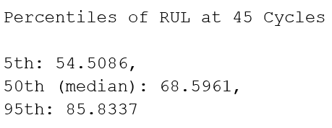
Matlab Code POST cont.
Plotting the histogram of RUL
figure(3); %% RUL Results Display
[frq,val]=hist(rul,30);
bar(val,frq/ns/(val(2)-val(1))); hold on;
xlabel(['RUL' ' (' TimeUnit ')']);
titleName=['at ' num2str(time(ny)) ' ' TimeUnit];
title(titleName)
fprintf(['\n Percentiles of RUL at %g ' TimeUnit], time(ny))
fprintf('\n %gth: %g, 50th (median): %g, %gth: %g \n', ...
perceValue(2),rulPrct(2),rulPrct(1),perceValue(3),rulPrct(3))

Slide 27
3. Bayesian Method (BM)

Slide 28
Bayesian Method (BM)
In terms of Chapter 3, BM corresponds to overall Bayesian method
  All training data (up to the current time) are used together to build the likelihood function
  The posterior distribution is obtained by multiplying the likelihood function with the prior distribution
For conjugate distribution, it is possible to generate samples from standard distributions
For single parameter estimation, the inverse CDF method can be used to generate samples
For general cases, Markov-chain Monte-Carly (MCMC) method will be used to generate samples
Using generated samples of model parameters, samples of RUL can be generated

Slide 29

Ex) MCMC Method: One Parameter
Draw 5000 samples from $A\sim N({5,2.9}^{2})$
Uniformly distributed proposal distribution
  STD of uniform distribution $={interval}/{\sqrt{12}}$
para0=5; weigh=5;
for i=1:5000
u=rand;
para1=unifrnd(para0-weigh, para0+weigh);
pdf1=normpdf(para1,5,2.9);
pdf0=normpdf(para0,5,2.9);
Q=min(1, pdf1/pdf0);
u=rand;
if u<Q; sampl(:,i)=para1; else sampl(:,i)=para0; end
para0=sampl(:,i);
end
plot(sampl); xlabel('Iteration (samples)'); ylabel('A')
figure; [frq,val]=hist(sampl,30);
bar(val,frq/5000/(val(2)-val(1))); hold on;
a=-10:0.1:20; plot(a,normpdf(a,5,2.9),'k')
xlabel('A'); legend('Sampling','Exact')

Slide 30
Ex) MCMC Method: One Parameter cont.
The quality of proposal distribution can be assessed using the trace of samples
Ex) para0=0.5, weigh=0.5
Trace does not show fluctuation with respect to the mean
The histogram does not agree with the analytical PDF

Slide 31
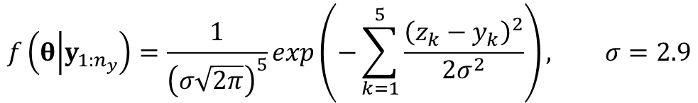


Ex) Multidimensional Correlated Sampling
Posterior PDF of $θ={\left\{θ_{1},θ_{2}\right\}}^{T}$
Model and data
$$f\left(θ | y_{1:n_{y}}\right)=\frac{1}{{\left(σ\sqrt{2π}\right)}^{5}}exp\left(−\sum_{k=1}^{5}{\frac{{\left(z_{k}−y_{k}\right)}^{2}}{2σ^{2}}}\right), σ=2.9$$
$$z_{k}=5+θ_{1}t_{k}^{2}+θ_{2}t_{k}^{3}, t=[0, 1, 2, 3, 4]$$
$$y=[6.99, 2.28, 1.91, 11.94, 14.60]$$
para0=[0; 1]; weigh=[0.05; 0.05]; s=2.9;
t = [0 1 2 3 4];
y=[6.99 2.28 1.91 11.94 14.60];
f0=5+para0(1)*t.^2+para0(2)*t.^3;
pdf0=(s*sqrt(2*pi))^-5*exp(-(f0-y)*(f0-y)'/(2*s^2));
para1=unifrnd(para0-weigh, para0+weigh);
f1=5+para1(1)*t.^2+para1(2)*t.^3;
pdf1=(s*sqrt(2*pi))^-5*exp(-(f1-y)*(f1-y)'/(2*s^2));

Slide 32
Ex) Multidimensional Correlated Sampling cont.
Due to a wrong initial point, first 200 samples are disregarded (burn-in)
Sample trace show that the weight is too small
para0=[0; 0], weigh=[0.3; 0.3],

Slide 33
Bayesian Method Matlab Code (BM)
Problem definition
function [thetaHat,rul]=BM(para0,weigh)
clear global; global DegraUnit initDisPar TimeUnit ...
time y thres ParamName thetaTrue signiLevel ns ny nt np
%=== PROBLEM DEFINITION 1 (Required Variables) ==============
WorkName=' '; % work results are saved by WorkName
DegraUnit=' '; % degradation unit
TimeUnit=' '; % time unit (Cycles, Weeks, etc.)
time=[ ]'; % time at both measurement and prediction
y=[ ]'; %[nyx1]: measured data
thres= ; % threshold (critical value)
ParamName=[ ]; %[npx1]: parameters' name to be estimated
initDisPar=[ ]; %[npx2]: prob. parameters of init./prior dist
thetaTrue=[ ]; %[npx1]: true values of parameters
signiLevel= ; % significance level for C.I. and P.I.
ns= ; % number of particles/samples
burnIn= ; % ratio for burn-in

Slide 34
BM Matlab Code cont.
%============================================================
% % % PROGNOSIS using BM with MCMC
ny=length(y); nt=ny;
np=size(ParamName,1);
sampl(:,1)=para0; %% Initial Samples
[~,jPdf0]=MODEL(para0,time(1:ny)); %% Initial (joint) PDF
for i=2:ns/(1-burnIn); %% MCMC Process
% proposal distribution (uniform)
para1(:,1)=unifrnd(para0-weigh,para0+weigh);
% (joint) PDF at new samples
[~,jPdf1]=MODEL(para1,time(1:ny));
% acceptance/rejection criterion
if rand<min(1,jPdf1/jPdf0)
para0=para1; jPdf0=jPdf1;
end;
sampl(:,i)=para0;
end;
nBurn=ns/(1-burnIn)-ns; %% Sampling Trace
figure(4);for j=1:np;subplot(np,1,j);plot(sampl(j,:));hold on
plot([nBurn nBurn],[min(sampl(j,:)) max(sampl(j,:))],'r');end
thetaHat=sampl(:,nBurn+1:end); %% Final Sampling Results
for k=1:length(time(ny:end)); %% Degradation Prediction
[zHat(k,:),~]=MODEL(thetaHat,time(ny-1+k));
degraPredi(k,:)=normrnd(zHat(k,:),thetaHat(end,:));
end;

Slide 35
BM Matlab Code cont.
% % % POST-PROCESSING
degraTrue=[]; %% True Degradation
if ~isempty(thetaTrue); degraTrue=MODEL(thetaTrue,time); end
rul=POST(thetaHat,degraPredi,degraTrue); %% RUL & Result Disp
Name=[WorkName ' at ' num2str(time(ny)) '.mat']; save(Name);
end
function [z,poste]=MODEL(param,t)
global y ParamName initDisPar ny np
for j=1:np; eval([ParamName(j,:) '=param(j,:);']); end
%===== PROBLEM DEFINITION 2 (model equation) ===============
%===========================================================
if length(y)~=length(t); poste=[];
else
prior= ... %% Prior
prod(unifpdf(param,initDisPar(:,1),initDisPar(:,2)));
likel=(1./(sqrt(2.*pi).*s)).^ny.* ... %% Likelihood
exp(-0.5./s.^2.*(y-z)'*(y-z));
poste=likel.*prior; %% Posterior
end
end

Slide 36

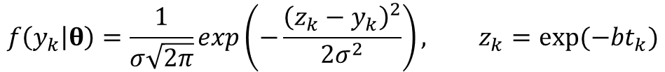
BM Implementation for Battery Prognostics
Normal likelihood
Prior distribution:
Problem definition (lines 5-16, 52)
  initDisPar: initial distribution parameters
  burnIn=0.2: initial 20% of samples will be discarded
All other problem definitions are the same as NLS
$$f\left(y_{k} | θ\right)=\frac{1}{σ\sqrt{2π}}exp\left(−\frac{{\left(z_{k}−y_{k}\right)}^{2}}{2σ^{2}}\right), z_{k}=exp⁡(−bt_{k})$$
$$θ={\left\{b,σ\right\}}^{T}$$
$$f\left(θ\right)=f\left(b\right)×f\left(σ\right), f\left(b\right)\sim U\left(0,0.02\right), f(σ)\sim U(1E−5,0.1)$$
initDisPar=[0 0.02; 1e-5 0.1];
burnIn=0.2;

Slide 37
BM Implementation for Battery Prognostics cont.
Calling BM:
  Initial parameters param0 = [0.01 0.05]’
  Weight of proposal distribution = [0.0005 0.01]’
  thetaHat: samples of estimated model parameters
  rul: samples of RUL
Two usages of MODEL
  MODEL returns degradation prediction z, and posterior PDF
  During model parameter estimation, posterior PDF poste is calculated using ny data
  During prognostics, MODEL is used to generate future degradation samples with future time
[thetaHat,rul]=BM([0.01 0.05]',[0.0005 0.01]');
function [z,poste]=MODEL(param,t)

Slide 38
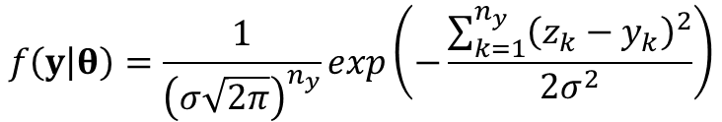
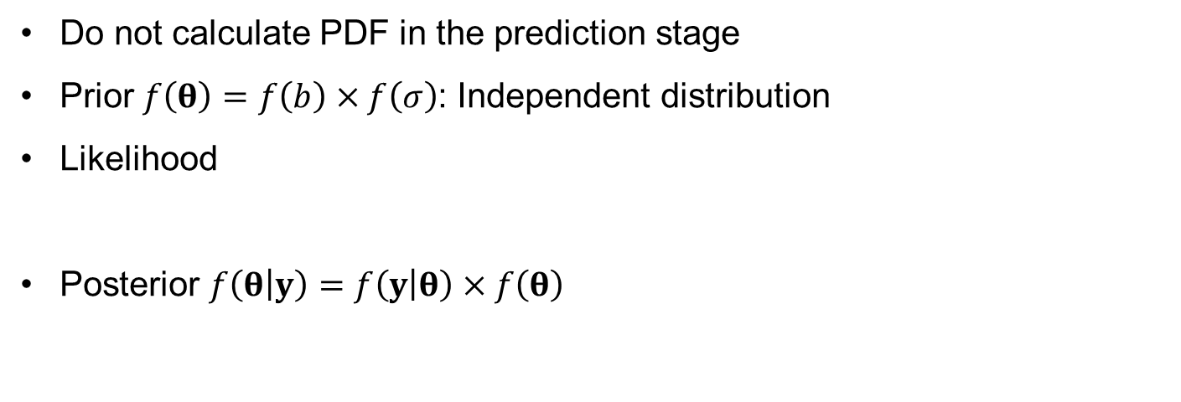
Overall BM Posterior PDF
if length(y)~=length(t); poste=[];
else
prior= ... %% Prior
prod(unifpdf(param,initDisPar(:,1),initDisPar(:,2)));
likel=(1./(sqrt(2.*pi).*s)).^ny.* ... %% Likelihood
exp(-0.5./s.^2.*(y-z)'*(y-z));
poste=likel.*prior; %% Posterior
end
Do not calculate PDF in the prediction stage
Prior $f\left(θ\right)=f\left(b\right)×f\left(σ\right)$: Independent distribution
Likelihood
Posterior $f\left(θ | y\right)=f\left(y | θ\right)×f\left(θ\right)$
$$f\left(y | θ\right)=\frac{1}{{\left(σ\sqrt{2π}\right)}^{n_{y}}}exp\left(−\frac{\sum_{k=1}^{n_{y}}{{\left(z_{k}−y_{k}\right)}^{2}}}{2σ^{2}}\right)$$

Slide 39
Prognostics using BM
Parameter estimation = generating samples from posterior distribution
  Using MCMC sampling
sampl(:,1)=para0; %% Initial Samples
[~,jPdf0]=MODEL(para0,time(1:ny)); %% Initial (joint) PDF
for i=2:ns/(1-burnIn); %% MCMC Process
% proposal distribution (uniform)
para1(:,1)=unifrnd(para0-weigh,para0+weigh);
% (joint) PDF at new samples
[~,jPdf1]=MODEL(para1,time(1:ny));
% acceptance/rejection criterion
if rand<min(1,jPdf1/jPdf0)
para0=para1; jPdf0=jPdf1;
end;
sampl(:,i)=para0;
end;

Slide 40
Sampling Trace
Remove the first nBurn samples
  Remaining number of samples = ns
nBurn=ns/(1-burnIn)-ns; %% Sampling Trace
figure(4);for j=1:np;subplot(np,1,j);plot(sampl(j,:));hold on
plot([nBurn nBurn],[min(sampl(j,:)) max(sampl(j,:))],'r');end

Slide 41
Post-processing (lines 43-46)
Basically the same with NLS
  Use POST with samples of parameters and degradations
Percentiles of RUL at 45 Cycles
5th: 54.3859,
50th (median): 68.3619,
95th: 82.8892

Slide 42
4. Particle Filter (PF)

Slide 43
Particle Filter
the most popular method in the physics-based prognostics
  fundamental concept is the same as the recursive Bayesian update
the prior and posterior PDF of parameters are represented by particles (samples)
the posterior at the previous step is used as the prior at the current step, and the parameters are updated by multiplying it with the likelihood from the new measurement
also known as the sequential Monte Carlo method

Slide 44
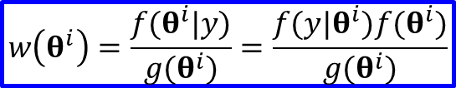
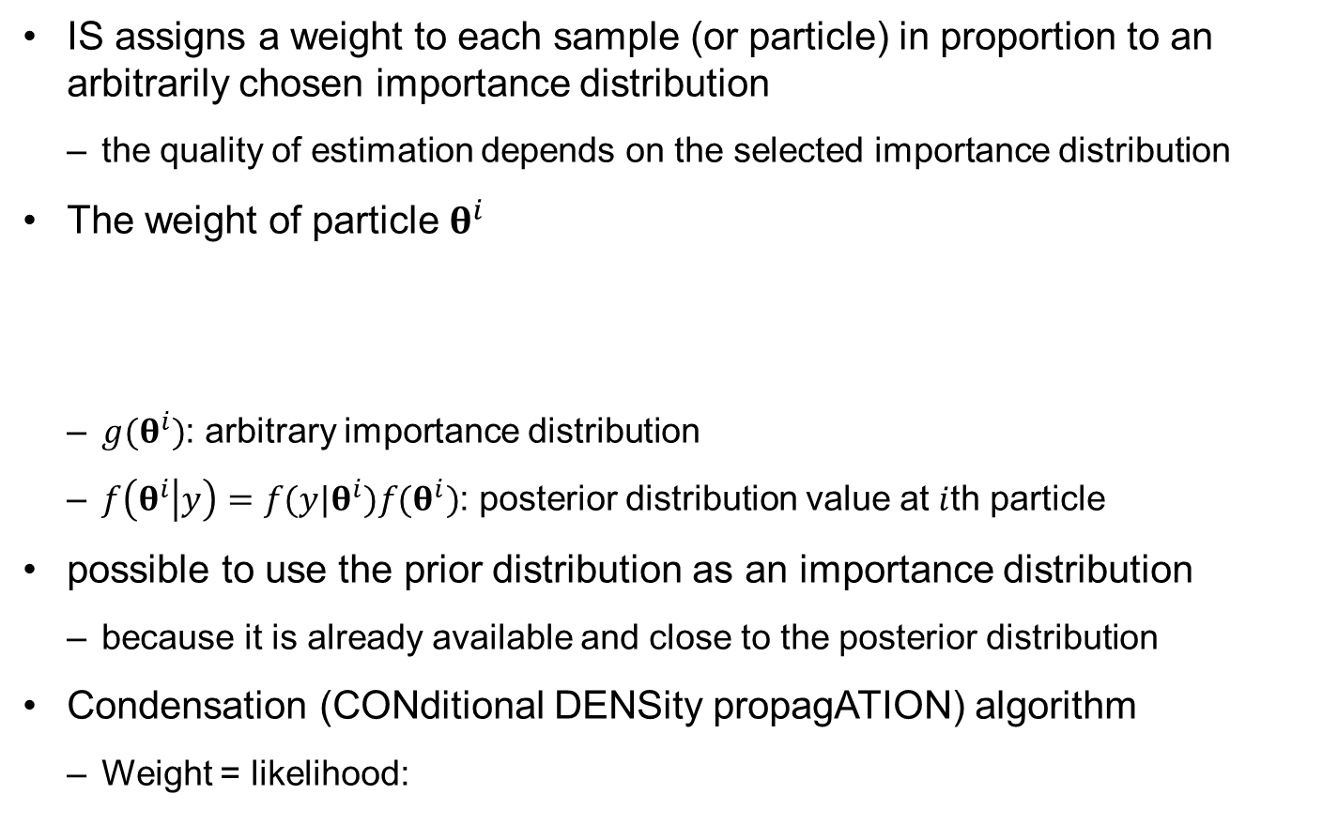

Review of Importance Sampling (IS)
IS assigns a weight to each sample (or particle) in proportion to an arbitrarily chosen importance distribution
  the quality of estimation depends on the selected importance distribution
The weight of particle $θ^{i}$
  $g(θ^{i})$: arbitrary importance distribution
  $f\left(θ^{i} | y\right)=f(y|θ^{i})f(θ^{i})$: posterior distribution value at $i$th particle
possible to use the prior distribution as an importance distribution
  because it is already available and close to the posterior distribution
Condensation (CONditional DENSity propagATION) algorithm
  Weight = likelihood:
$$w\left(θ^{i}\right)=\frac{f(θ^{i}|y)}{g(θ^{i})}=\frac{f(y|θ^{i})f(θ^{i})}{g(θ^{i})}$$
$$w\left(θ^{i}\right)=f(y|θ^{i})$$

Slide 45
Sequential IS
PF can be considered as a sequential importance sampling method
  weights are continuously updated whenever a new observation is available
Degeneracy phenomenon
  happens when weights are updated with the same initial samples
  decreases the accuracy in the posterior distribution with a large variance
sequential importance resampling (SIR)
  Small weight particles are removed
  High weight particles are duplicated

Slide 46

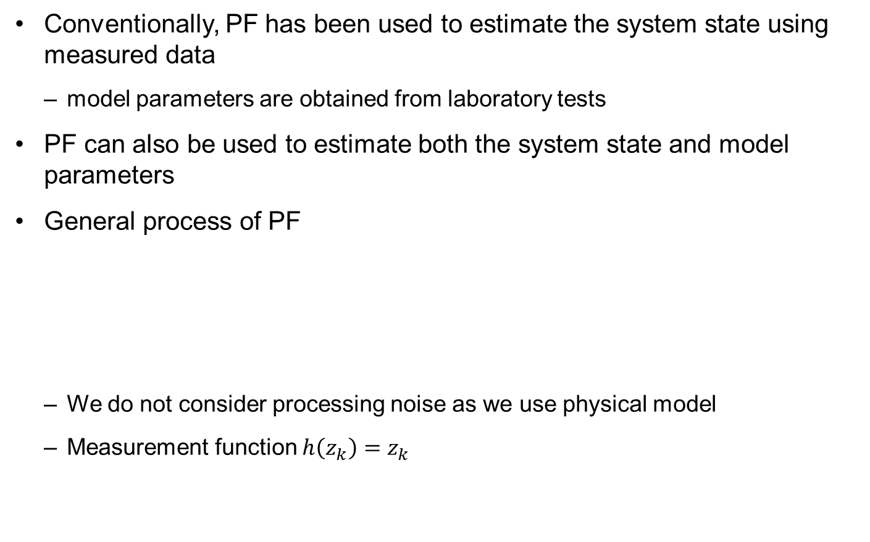
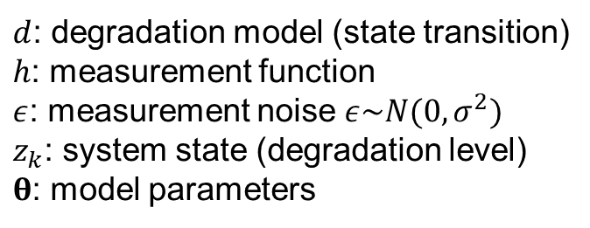
General Process of PF
Conventionally, PF has been used to estimate the system state using measured data
  model parameters are obtained from laboratory tests
PF can also be used to estimate both the system state and model parameters
General process of PF
  We do not consider processing noise as we use physical model
  Measurement function $h\left(z_{k}\right)=z_{k}$
$d$: degradation model (state transition)
$h$: measurement function
$ε$: measurement noise $ε\sim N(0,σ^{2})$
$z_{k}$: system state (degradation level)
$θ$: model parameters
$$z_{k}=d\left(z_{k−1};θ\right) \\ y_{k}=h\left(z_{k}\right)+ε$$

Slide 47

Application to Battery Degradation
Rewrite the battery degradation model in terms of PF process
Ratio
PF form:
$$z_{k−1}=\exp\left(−bt_{k−1}\right), z_{k}=\exp\left(−bt_{k}\right)$$
$$\frac{z_{k}}{z_{k−1}}=\frac{\exp\left(−bt_{k}\right)}{\exp\left(−bt_{k−1}\right)}=exp⁡(−bt_{k}+bt_{k−1})$$
$$z_{k}=\exp\left(−bΔt\right)z_{k−1}; Δt=t_{k}−t_{k−1}$$

Slide 48

SIR Process
Initial step $(k=1)$
  Generate $n_{s}$ samples (particles) of degradation and model parameters based on the prior distribution
  Same initial weight for all particles: $w\left(θ^{i}\right)=1/{n_{s}}$

Slide 49


SIR Process: Prediction
Use step $k−1$ as a prior distribution
  available $f\left(θ_{k−1} | y_{1:k−1}\right),f\left(z_{k−1} | y_{1:k−1}\right)$ in the form of samples
degradation state at $t_{k−1}$ is propagated to $t_{k}$ in the form of samples
  No transition for model parameters: $θ_{k}=θ_{k−1}$
  Draw $n_{s}$ samples of $z_{k}$ based on $f(z_{k}|z_{k−1},θ_{k})$
Ex) Battery degradation
$$z_{k}=\exp\left(−b_{k}Δt\right)z_{k−1}$$

Slide 50
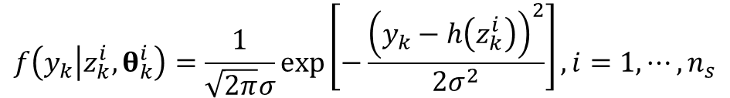

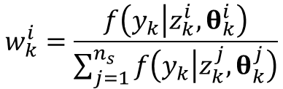
SIR Process: Update
Model parameters and degradation state are updated (corrected) based on the likelihood function from measured data $y_{k}$ at the current step
  Likelihood: the probability of obtaining $y_{k}$ conditional on each sample
Weight calculation as a normalized likelihood
$$f\left(y_{k} | z_{k}^{i},θ_{k}^{i}\right)=\frac{1}{\sqrt{2π}σ}exp\left[−\frac{{\left(y_{k}−h\left(z_{k}^{i}\right)\right)}^{2}}{2σ^{2}}\right], i=1,⋯,n_{s}$$
$$w_{k}^{i}=\frac{f\left(y_{k} | z_{k}^{i},θ_{k}^{i}\right)}{\sum_{j=1}^{n_{s}}{f\left(y_{k} | z_{k}^{j},θ_{k}^{j}\right)}}$$

Slide 51

SIR Process: Update cont.
Posterior distribution = sample $×$ weight
  After update, some samples have a high weight, some samples have a low weight
Cause degeneracy problem
  decreases the accuracy in the posterior distribution
  causes the lack of reducing the range of distribution by keeping samples with low weights

Slide 52
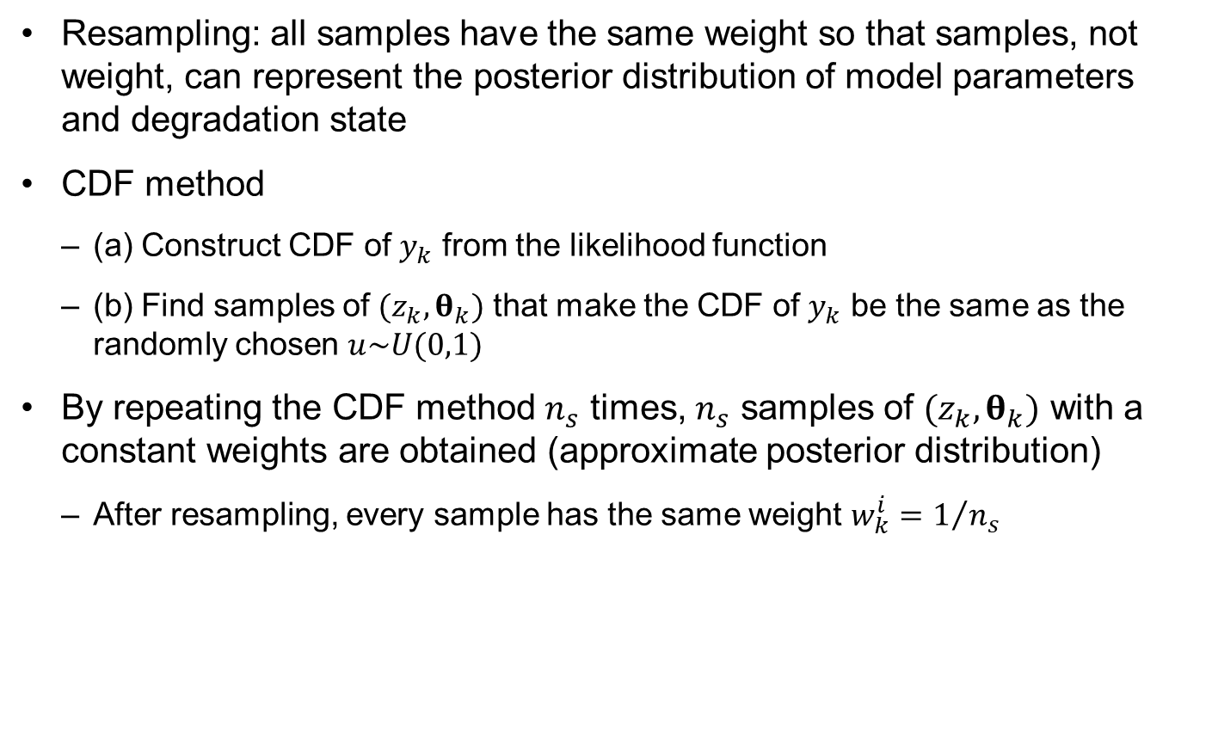
SIR Process: Resampling
Resampling: all samples have the same weight so that samples, not weight, can represent the posterior distribution of model parameters and degradation state
CDF method
  (a) Construct CDF of $y_{k}$ from the likelihood function
  (b) Find samples of $(z_{k}, θ_{k})$ that make the CDF of $y_{k}$ be the same as the randomly chosen $u\sim U(0,1)$
By repeating the CDF method $n_{s}$ times, $n_{s}$ samples of $(z_{k}, θ_{k})$ with a constant weights are obtained (approximate posterior distribution)
  After resampling, every sample has the same weight $w_{k}^{i}=1/{n_{s}}$

Slide 53
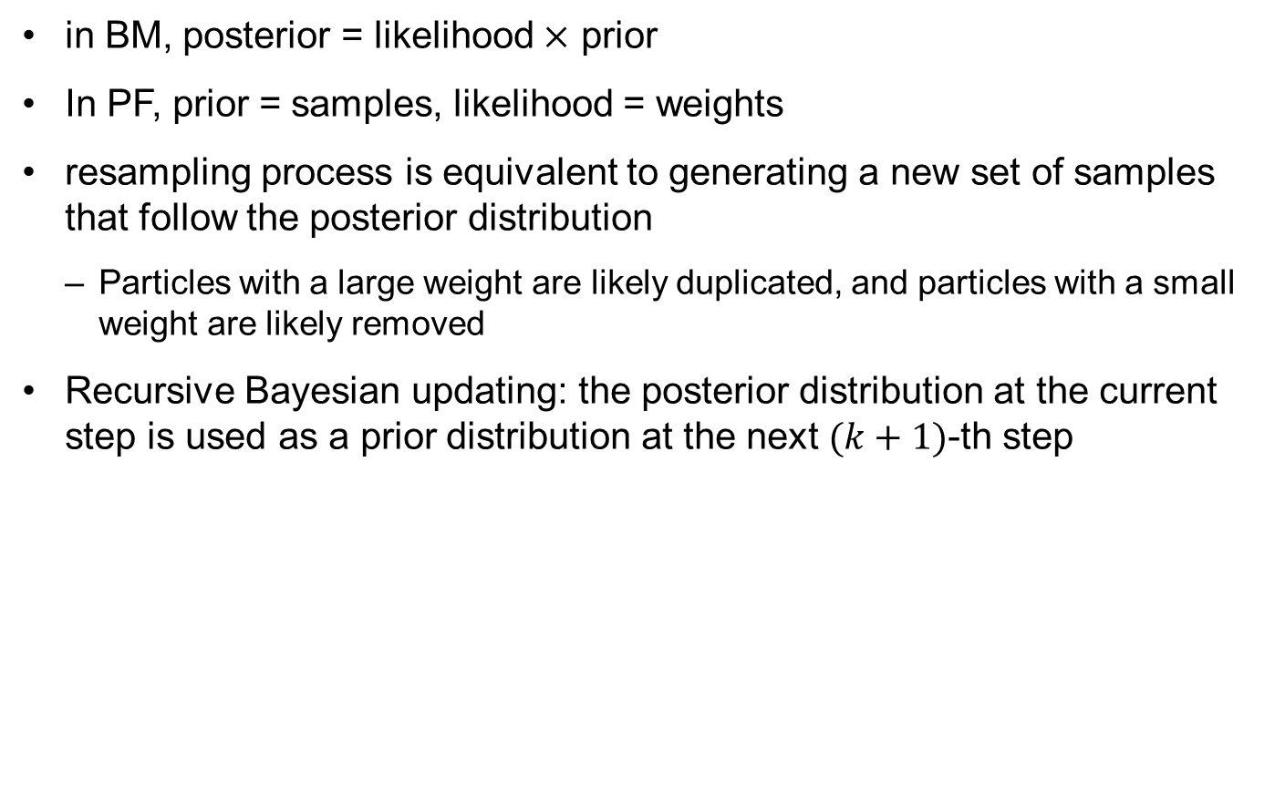
SIR Process: Resampling cont.
in BM, posterior = likelihood $×$ prior
In PF, prior = samples, likelihood = weights
resampling process is equivalent to generating a new set of samples that follow the posterior distribution
  Particles with a large weight are likely duplicated, and particles with a small weight are likely removed
Recursive Bayesian updating: the posterior distribution at the current step is used as a prior distribution at the next $(k+1)$-th step

Slide 54
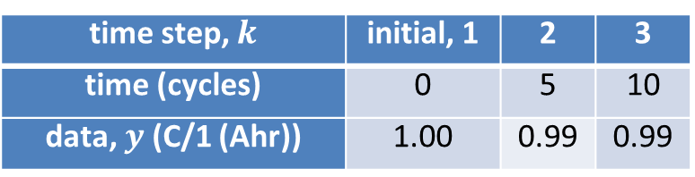

Ex) PF of Battery Degradation with 10 Samples
initial distributions: $z_{1}\sim U\left(0.9,1.1\right), b_{1}\sim U\left(0, 0.005\right), σ=0.02$
At $k=1$
  Generate 10 samples from the initial distributions
time step, $k$ | initial, 1 | 2 | 3
time (cycles) | 0 | 5 | 10
data, $y$ (C/1 (Ahr)) | 1.00 | 0.99 | 0.99
k=1; ns=10;
b(k,:)=unifrnd(0,0.005,ns,1);
z(k,:)=unifrnd(0.9,1.1,ns,1);
figure; subplot(1,2,1);
plot(b(k,:),zeros(1,ns),'ok'); xlabel('b (parameter)')
subplot(1,2,2);
plot(z(k,:),zeros(1,ns),'ok'); xlabel('z (degradation)')

Slide 55


Ex) PF of Battery Degradation with 10 Samples
At $k=2$: Prediction
  Same parameter, propagating model prediction
$$θ_{2}=θ_{1}, z_{2}=\exp\left(−bΔt\right)z_{1}$$
k=2; dt=5;
b(k,:)=b(k-1,:);
z(k,:)=exp(-b(k,:).*dt).*z(k-1,:);
% for figure plot, use the same code given in k=1

Slide 56
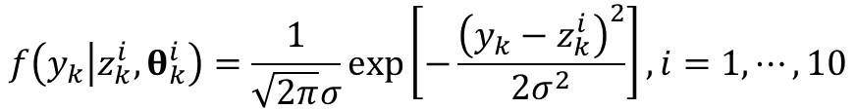

Ex) PF of Battery Degradation with 10 Samples
At $k=2$: Update
  Calculate likelihood
  Weights are normalized (sum = 1)
  Scaled weights = weights $×n_{s}$: weights are the number of samples to be duplicated
$$f\left(y_{k} | z_{k}^{i},θ_{k}^{i}\right)=\frac{1}{\sqrt{2π}σ}exp\left[−\frac{{\left(y_{k}−z_{k}^{i}\right)}^{2}}{2σ^{2}}\right], i=1,⋯,10$$
likel=normpdf(y(k,:),z(k,:),0.02);
weigh=round(likel/sum(likel)*ns);
figure; subplot(1,2,1); stem(b(k,:),weigh,'r');
xlabel('b (parameter)'); ylabel('Weight')
subplot(1,2,2); stem(z(k,:),weigh,'r');
xlabel('z (degradation)'); ylabel('Weight')

Slide 57

Ex) PF of Battery Degradation with 10 Samples
At $k=2$: Resampling
  Inverse CDF can be used
  We will simply remove samples with zero weights, other samples are duplicated as many as the weight
Several samples are overlapped: particle depletion
sampl=[b(k,:); z(k,:)];
loca=find(weigh>0); ns0=1;
for i=1:length(loca);
ns1=sum(weigh(loca(1:i)));
b(k,ns0:ns1)=sampl(1,loca(i))*ones(1,weigh(loca(i)));
z(k,ns0:ns1)=sampl(2,loca(i))*ones(1,weigh(loca(i)));
ns0=ns1+1;
end

Slide 58

Ex) PF of Battery Degradation with 10 Samples
At $k=3$: Prediction, Update, and Resampling

Slide 59
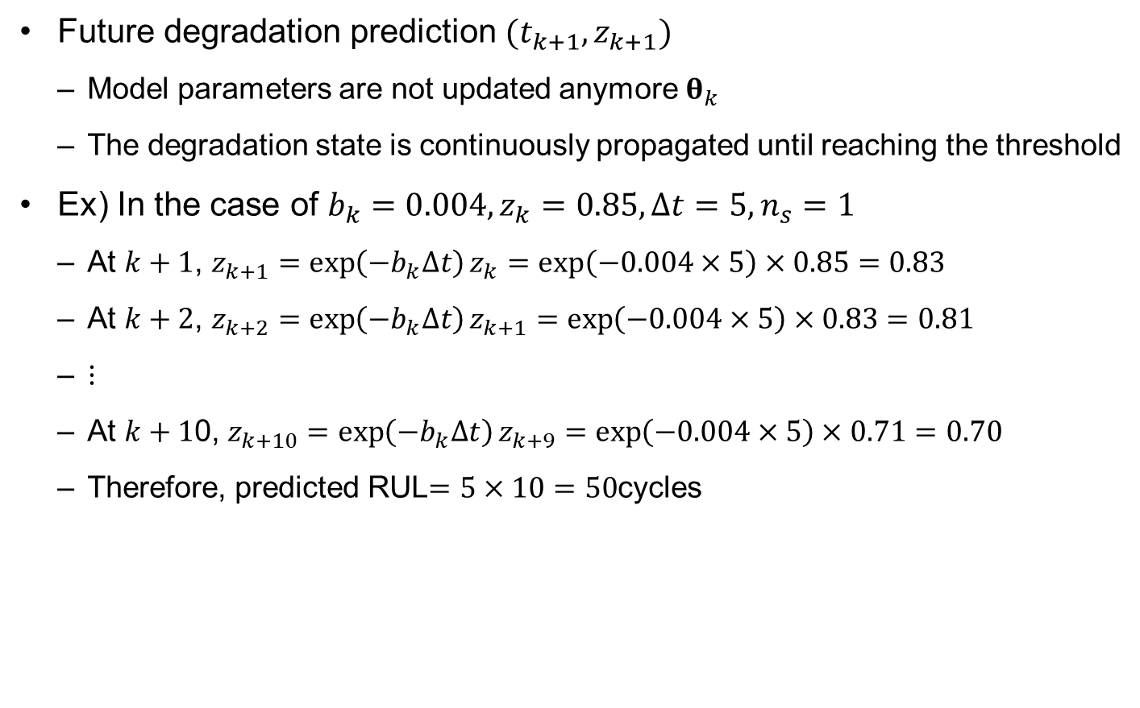
Ex) PF of Battery Degradation with 10 Samples
Future degradation prediction $(t_{k+1},z_{k+1})$
  Model parameters are not updated anymore $θ_{k}$
  The degradation state is continuously propagated until reaching the threshold
Ex) In the case of $b_{k}=0.004, z_{k}=0.85, Δt=5, n_{s}=1$
  At $k+1$, $z_{k+1}=\exp\left(−b_{k}Δt\right)z_{k}=\exp\left(−0.004×5\right)×0.85=0.83$
  At $k+2$, $z_{k+2}=\exp\left(−b_{k}Δt\right)z_{k+1}=\exp\left(−0.004×5\right)×0.83=0.81$
  $⋮$
  At $k+1$0, $z_{k+10}=\exp\left(−b_{k}Δt\right)z_{k+9}=\exp\left(−0.004×5\right)×0.71=0.70$
  Therefore, predicted RUL$=5×10=50$cycles

Slide 60
Particle Filter (PF) Matlab Code
function [thetaHat,rul]=PF
clear global; global DegraUnit initDisPar TimeUnit ...
time y thres ParamName thetaTrue signiLevel ns ny nt np
%=== PROBLEM DEFINITION 1 (Required Variables) ==============
WorkName=' '; % work results are saved by WorkName
DegraUnit=' '; % degradation unit
TimeUnit=' '; % time unit (Cycles, Weeks, etc.)
time=[ ]'; % time at both measurement and prediction
dt= ; % time interval for degradation propagation
y=[ ]'; %[nyx1]: measured data
thres= ; % threshold (critical value)
ParamName=[ ]; %[npx1]: parameters' name to be estimated
initDisPar=[ ]; %[npx2]: prob. parameters of init./prior dist
thetaTrue=[ ]; %[npx1]: true values of parameters
signiLevel= ; % significance level for C.I. and P.I.
ns= ; % number of particles/samples

Slide 61
PF Matlab Code cont.
% % % PROGNOSIS using PF
ny=length(y); nt=ny;
np=size(ParamName,1);
for j=1:np; %% Initial Distribution
param(j,:,1)=unifrnd(initDisPar(j,1),initDisPar(j,2),1,ns);
end;
for k=2:length(time); %% Update Process or Prognosis
paramPredi=param(:,:,k-1); % step1. prediction (prior)
nk=(time(k)-time(k-1))/dt;
for k0=1:nk; paramPredi(np,:)=MODEL(paramPredi,dt); end
if k<=ny % (Update Process)
% step2. update (likelihood)
likel=normpdf(y(k),paramPredi(np,:),paramPredi(np-1,:));
cdf=cumsum(likel)./sum(likel); % step3. resampling
for i=1:ns;
u=rand;
loca=find(cdf>=u,1); param(:,i,k)=paramPredi(:,loca);
end;
else % (Prognosis)
param(:,:,k)=paramPredi;
end
end
thetaHat=param(1:np-1,:,ny); %% Final Sampling Results
paramRearr=permute(param,[3 2 1]); %% Degradation Prediction
zHat=paramRearr(:,:,np);
degraPredi=normrnd(zHat(ny:end,:),paramRearr(ny:end,:,np-1));

Slide 62
PF Matlab Code cont.
% % % POST-PROCESSING
degraTrue=[]; %% True Degradation
if ~isempty(thetaTrue); k=1;
degraTrue0(1)=thetaTrue(np); degraTrue(1)=thetaTrue(np);
for k0=2:max(time)/dt+1;
degraTrue0(k0,1)= ...
MODEL([thetaTrue(1:np-1); degraTrue0(k0-1)],dt);
loca=find((k0-1)*dt==time,1);
if ~isempty(loca); k=k+1; degraTrue(k)=degraTrue0(k0);end
end
end
rul=POST(thetaHat,degraPredi,degraTrue); %% RUL & Result Disp
Name=[WorkName ' at ' num2str(time(ny)) '.mat']; save(Name);
end
function z1=MODEL(param,dt)
global ParamName np
for j=1:np; eval([ParamName(j,:) '=param(j,:);']); end
%===== PROBLEM DEFINITION 2 (model equation) ===============
%===========================================================
end

Slide 63
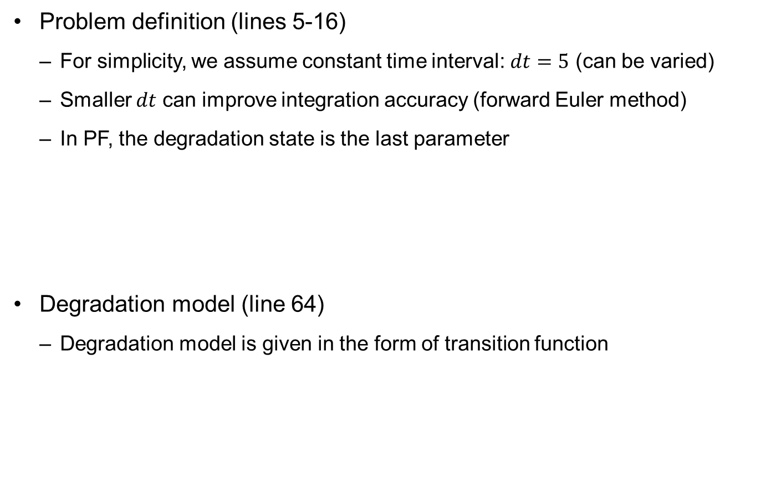
Matlab Implementation for Battery Prognostics
Problem definition (lines 5-16)
  For simplicity, we assume constant time interval: $dt=5$ (can be varied)
  Smaller $dt$ can improve integration accuracy (forward Euler method)
  In PF, the degradation state is the last parameter
Degradation model (line 64)
  Degradation model is given in the form of transition function
dt=5;
ParamName=['b'; 's'; 'z'];
initDisPar=[0 0.02; 1e-5 0.1; 1 1];
thetaTrue=[0.003; 0.02; 1];
No uncertainty in
initial prediction
z1=exp(-b.*dt).*z;

Slide 64
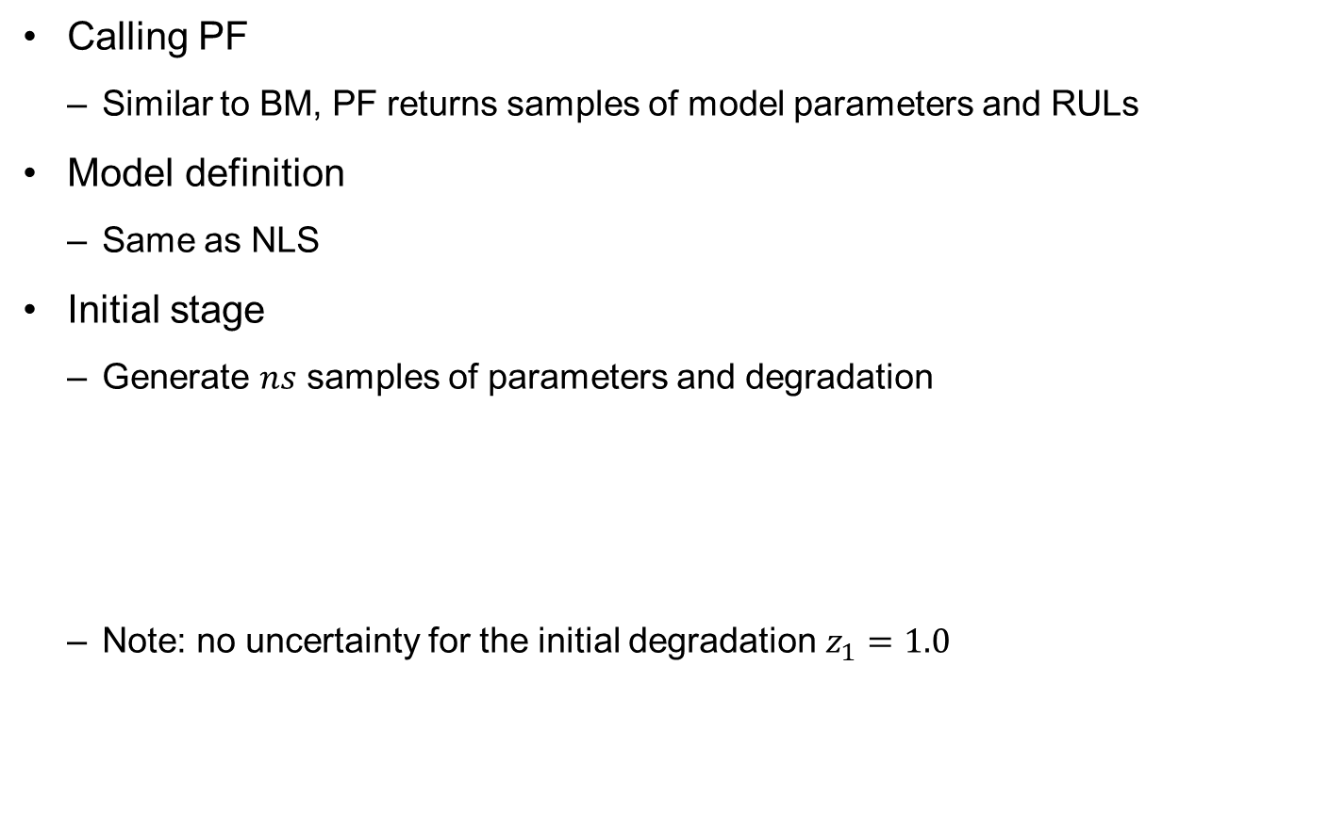
Matlab Implementation for Battery Prognostics
Calling PF
  Similar to BM, PF returns samples of model parameters and RULs
Model definition
  Same as NLS
Initial stage
  Generate $ns$ samples of parameters and degradation
  Note: no uncertainty for the initial degradation $z_{1}=1.0$
[thetaHat,rul]=PF;
for j=1:np; %% Initial Distribution
param(j,:,1)=unifrnd(initDisPar(j,1),initDisPar(j,2),1,ns);
end;

Slide 65

Matlab Implementation for Battery Prognostics
Step 1: Prediction (prior)
  No change in model parameters (same values from the previous time)
  Propagate degradation using the model
  If $dt<Δt$, multiple steps are used to integration the degradation
Step 2: Update
  Based on every sample of degradation $z_{k}$ and measurement $y_{k}$
% step1. prediction (prior)
paramPredi=param(:,:,k-1);
nk=(time(k)-time(k-1))/dt;
for k0=1:nk; paramPredi(np,:)=MODEL(paramPredi,dt); end
if k<=ny % (Update Process)
% step2. update (likelihood)
likel=normpdf(y(k),paramPredi(np,:),paramPredi(np-1,:));

Slide 66

Matlab Implementation for Battery Prognostics
Step 3: Resampling
  cdf: cumulative CDF of likelihood samples
  Using a random sample $u\sim U(0,1)$, find the new sample location that corresponds to $u = cdf$approximately
  a sample with a large likelihood (weight) has more probability to be duplicated, while a sample with a small likelihood may not be reproduced
% step3. resampling
cdf=cumsum(likel)./sum(likel);
for i=1:ns;
u=rand;
loca=find(cdf>=u,1);
param(:,i,k)=paramPredi(:,loca);
end;
else % (Prognosis)
param(:,:,k)=paramPredi;
end

Slide 67
Matlab Implementation for Battery Prognostics
Post-processing
  Basically identical to NLS and BM
  Since degradation is a part of param, rearrange arrayes
thetaHat=param(1:np-1,:,ny); %% Final Sampling Results
paramRearr=permute(param,[3 2 1]); %% Degradation Prediction
zHat=paramRearr(:,:,np);
degraPredi=normrnd(zHat(ny:end,:),paramRearr(ny:end,:,np-1));

Slide 68
5. Practical Application of Physics-based Prognostics

Slide 69
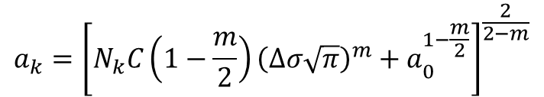


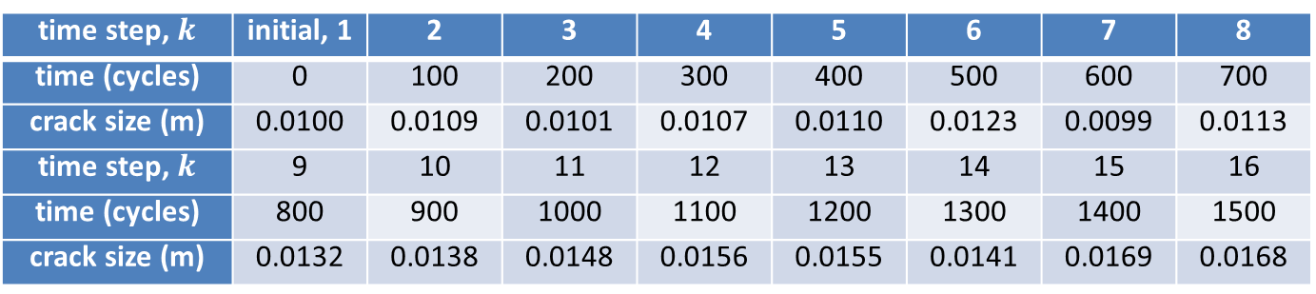

Crack Growth Model Definition
$$\frac{da}{dN}=C{\left(ΔK\right)}^{m}, ΔK=Δσ\sqrt{πa}$$
Paris crack growth model:
  NLS and BM require the degradation model as a function of time/cycle
  PF requires the model as a transition function (incremental form)
Assume $Δσ=75MPa$, $dN=100$cycles
$$a_{k}={\left[N_{k}C\left(1−\frac{m}{2}\right){\left(Δσ\sqrt{π}\right)}^{m}+a_{0}^{1−\frac{m}{2}}\right]}^{\frac{2}{2−m}}$$
$$a_{k}=C{\left(Δσ\sqrt{πa_{k−1}}\right)}^{m}dN+a_{k−1}$$
time step, $k$ | initial, 1 | 2 | 3 | 4 | 5 | 6 | 7 | 8
time (cycles) | 0 | 100 | 200 | 300 | 400 | 500 | 600 | 700
crack size (m) | 0.0100 | 0.0109 | 0.0101 | 0.0107 | 0.0110 | 0.0123 | 0.0099 | 0.0113
time step, $k$ | 9 | 10 | 11 | 12 | 13 | 14 | 15 | 16
time (cycles) | 800 | 900 | 1000 | 1100 | 1200 | 1300 | 1400 | 1500
crack size (m) | 0.0132 | 0.0138 | 0.0148 | 0.0156 | 0.0155 | 0.0141 | 0.0169 | 0.0168

Slide 70

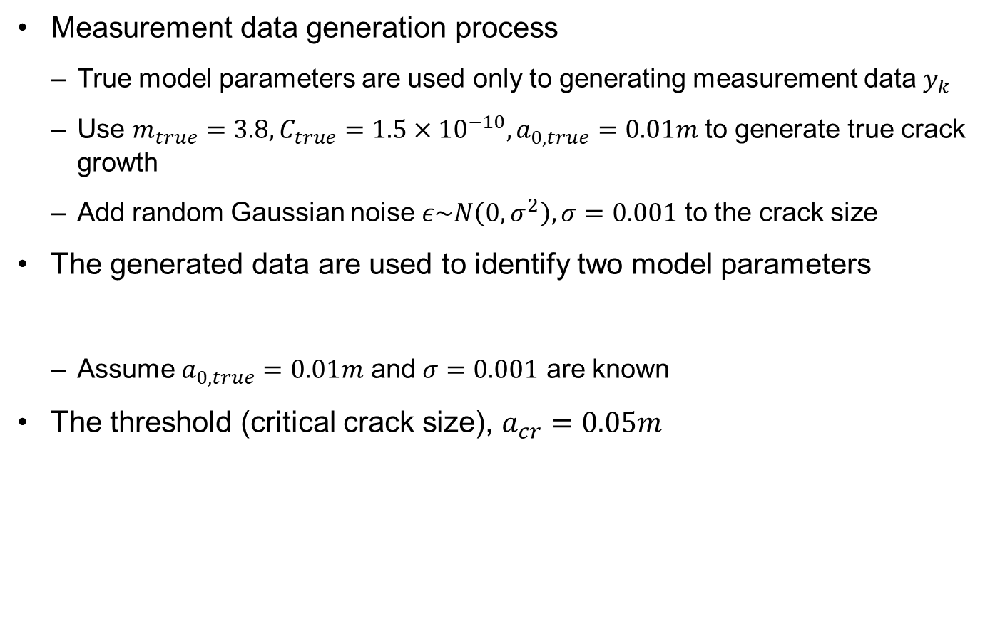
Crack Growth Model Definition
Measurement data generation process
  True model parameters are used only to generating measurement data $y_{k}$
  Use $m_{true}=3.8, C_{true}=1.5×{10}^{−10}, a_{0,true}=0.01m$ to generate true crack growth
  Add random Gaussian noise $ε\sim N\left(0,σ^{2}\right), σ=0.001$ to the crack size
The generated data are used to identify two model parameters
  Assume $a_{0,true}=0.01m$ and $σ=0.001$ are known
The threshold (critical crack size), $a_{cr}=0.05m$
$$θ={\left\{m,\ln\left(C\right)\right\}}^{T}$$

Slide 71
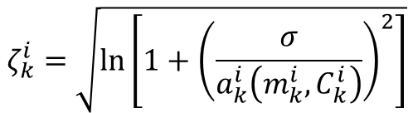



Likelihood and Prior Distribution
In order to study the effect of different distribution type, we assume likelihood is from a lognormal distribution
  This means that random measurement noise is lognormally distributed
  Standard deviation:
  Mean:
Prior distribution
$$f(y_{k}|m_{k}^{i},C_{k}^{i})=\frac{1}{y_{k}\sqrt{2π}ζ_{k}^{i}}\exp\left[−\frac{1}{2}{\left(\frac{\ln{y_{k}}−η_{k}^{i}}{ζ_{k}^{i}}\right)}^{2}\right], i=1,⋯,n_{s}$$
$$ζ_{k}^{i}=\sqrt{\ln\left[1+{\left(\frac{σ}{a_{k}^{i}\left(m_{k}^{i},C_{k}^{i}\right)}\right)}^{2}\right]}$$
$$η_{k}^{i}=\ln\left[a_{k}^{i}\left(m_{k}^{i},C_{k}^{i}\right)\right]−\frac{1}{2}{\left(ζ_{k}^{i}\right)}^{2}$$
$a_{k}^{i}\left(m_{k}^{i},C_{k}^{i}\right)$: model prediction
(crack size)
$$f\left(m\right)=N\left(4,{0.2}^{2}\right), f\left(\log{C}\right)=N(−{23,1.1}^{2})$$

Slide 72

Modifying NLS Matlab Code
Problem definition part
  $σ$ is not a parameter, but it is calculated based on the identified parameters
WorkName='Crack_NLS';
DegraUnit='Crack size (m)';
TimeUnit='Cycles';
time=[0:100:3500]';
y=[0.0100 0.0109 0.0101 0.0107 0.0110 0.0123 0.0099 0.0113...
0.0132 0.0138 0.0148 0.0156 0.0155 0.0141 0.0169 0.0168]';
thres=0.05;
ParamName=['m'; 'C'; 's'];
thetaTrue=[3.8; log(1.5e-10); 0.001];
signiLevel=5;
ns=5e3;

Slide 73

Modifying NLS Matlab Code cont.
Model definition
  $\ln{(C)}$ is used instead of $C$
  When the crack size grows too large, $z$ becomes a complex number
  We replace complex crack size with an arbitrary large value $z=1.0$
a0=0.01; dsig=75;
z=(t.*exp(C).*(1-m./2).*(dsig*sqrt(pi)).^m ...
+a0.^(1-m./2)).^(2./(2-m));
loca=imag(z)~=0; z(loca)=1;

Slide 74
Modifying NLS Matlab Code cont.
Likelihood
  Likelihood is unnecessary for NLS, but it is used to predict degradation
Calling NLS
mu=zHat(k,:);
C=chi2rnd(ny-1,1,ns);
s=sqrt((ny-1)*thetaHat(np,:).^2./C);
zeta=sqrt(log(1+(s./mu).^2)); eta=log(mu)-0.5*zeta.^2;
degraPredi(k,:)=lognrnd(eta,zeta);
[thetaHat,rul]=NLS([4; -23]);

Slide 75

Modifying BM Matlab Code
Problem definition
  In addition to NLS problem definition, add the following information
  If noise $σ$ is given, put STD of s = 0 (1E-5 for preventing numerical error)
Model definition
Calling BM
WorkName='Crack_BM';
initDisPar=[4.0 0.2; -23 1.1; 0.001 1e-5];
burnIn=0.2;
prior=prod(normpdf(param,initDisPar(:,1),initDisPar(:,2)));
likel=1;
for k=1:ny;
zeta=sqrt(log(1+(s./z(k)).^2)); eta=log(z(k))-0.5*zeta.^2;
likel=lognpdf(y(k),eta,zeta).*likel;
end
[thetaHat]=BM([4 -23 0.001]',[0.1 0.2 0]');

Slide 76
Modifying PF Matlab Code
Problem definition
  PF includes state ‘a’ as the last parameter
Model definition
WorkName='Crack_PF';
dt=20;
ParamName=['m'; 'C'; 's'; 'a'];
initDisPar=[4.0 0.2; -23 1.1; 0.001 0; 0.01 0];
thetaTrue=[3.8;log(1.5e-10); 0.001; 0.01];
dsig=75;
z1=exp(C).*(dsig.*sqrt(pi*a)).^m.*dt+a;

Slide 77
Modifying PF Matlab Code cont.
Predicting degradation (logarithmic distribution)
Initial distribution
Likelihood (weight)
Calling PF
mu=zHat(ny:end,:); s=paramRearr(ny:end,:,np-1);
zeta=sqrt(log(1+(s./mu).^2)); eta=log(mu)-0.5*zeta.^2;
degraPredi=lognrnd(eta,zeta);
param(j,:,1)=normrnd(initDisPar(j,1),initDisPar(j,2),1,ns);
mu=paramPredi(np,:); s=paramPredi(np-1,:);
zeta=sqrt(log(1+(s./mu).^2)); eta=log(mu)-0.5*zeta.^2;
likel=lognpdf(y(k),eta,zeta);
[thetaHat,rul]=PF;

Slide 78
Comparison of Results
Correlation plot
  A large uncertainty in the results from NLS compared to the others (because no prior information is employed)
  Large uncertainty in parameters leads to large uncertainty in degradation prediction
  PF is still not showing smooth distribution of particles
plot(thetaHat(1,:),thetaHat(2,:),'.').

Slide 79

Comparison of Results
Degradation prediction plot
  Median prediction follows the true degradation for all three methods
  Much larger uncertainty in NLS
  PF has a model error in integrating the incremental equation with $dt=20$.

Slide 80
6. Issues in Physics-based Prognostics

Slide 81
Advantages of Physics-base Prognostics
Can make a long-term prediction
  Possible to predict the RUL by propagating the degradation model to future time
Require relatively a small number of data
  Theoretically, require the # of data same as that of model parameters
  In reality, a greater number of data are required due to noise in data and due to insensitivity of degradation behavior to parameters
  But the required number of data is much less than that of data-driven methods.

Slide 82

Model Adequacy
Question: Is the physical model good enough to predict the future behavior of degradation?
  In particular, is the model good in the extrapolation region?
An adequate model in the interpolation region can be inadequate in the extrapolation region
  Important to validate the physical model for the purpose of prognostics
Validation data
Under-estimation
of degradation
Training data
Fitted model

Slide 83
Parameter Estimation
Estimation accuracy is related to characteristics of different algorithms, such as NLS, BM and PF
Correlations between model parameters and also between model parameters and loading conditions hinders identifying accurate parameters
A good prognostics algorithm can identify accurate model parameters with a smaller number of data
Correlation: even if the accurate identification of parameters might be difficult, it is possible that accurate prediction in degradation and RUL are still possible

Slide 84
Quality of Degradation Data
Data could include a high level of noise and bias due to the sensor equipment and measurement environment
  Noise is a random fluctuation in measured data or signal due to interference or unwanted electromagnetic fields in electronic devices
  Bias is static deviation of signals from correct ones, which can happen due to calibration error
Noise makes it difficult to identify signals related to degradation, while bias in-duces error in prediction

